Slide 1
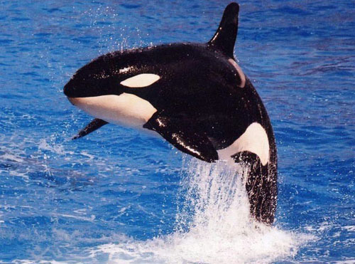
Report on orcas
The orca (commonly referred to as the killer whale) is the largest dolphin. Resident orcas eat fish where as transient orcas eat seal, sea lion, small whales and even sharks. Resident orcas use echolocation clicks to find their prey and transient orcas make waves to wash seals of icebergs. They are also so smart they can drown whales and turn over sharks, sending them into a trance. They have a large dorsal (back) fin and a white jaw and eye patch. They can also grow to be more than 5 meters long.

