Slide 1
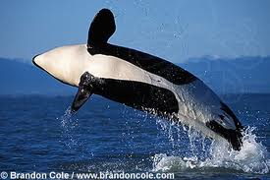
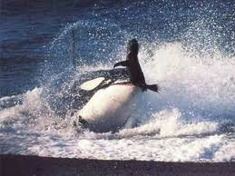
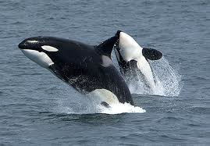
Orcas
Breaching killer whale
Killer whale preying on seal
Mother and calf

Slide 2
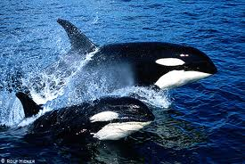
Orca (killer whale)
orcas are the largest species of the dolphin family the orca and all dolphins use a series of echolocation noises to find their prey. For an orca to catch a seal on a small floating iceberg the pod will make a wave to wash the seal off, once they have caught the seal they will throw it and play with it.

Slide 3
Prey
Orcas eat fish, squid, seals, sea lions, birds, otters, penguins, polar bears, smaller whales and even sharks.
Information from dolphins- world.com

Slide 4
Glossary
Breaching – leaping out the water
Calf – baby orca
Pod – a group of orca
Preying - feeding

