Slide 1
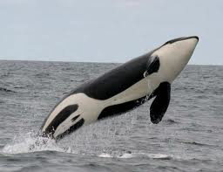
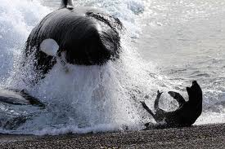
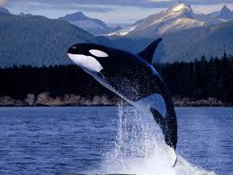
White belly
Transient orca preying on seal
Blow hole
White patch

Slide 2
Orca (killer whale)
Kingdom: Animalia
Group: mammalia
Family: delphinum
Diet of a transient orca.
Transient orcas eat: seals, sea lions, small whales and even sharks.
Diet of a resident orca
Resident orcas eat: Fish and squid

